Slide 1
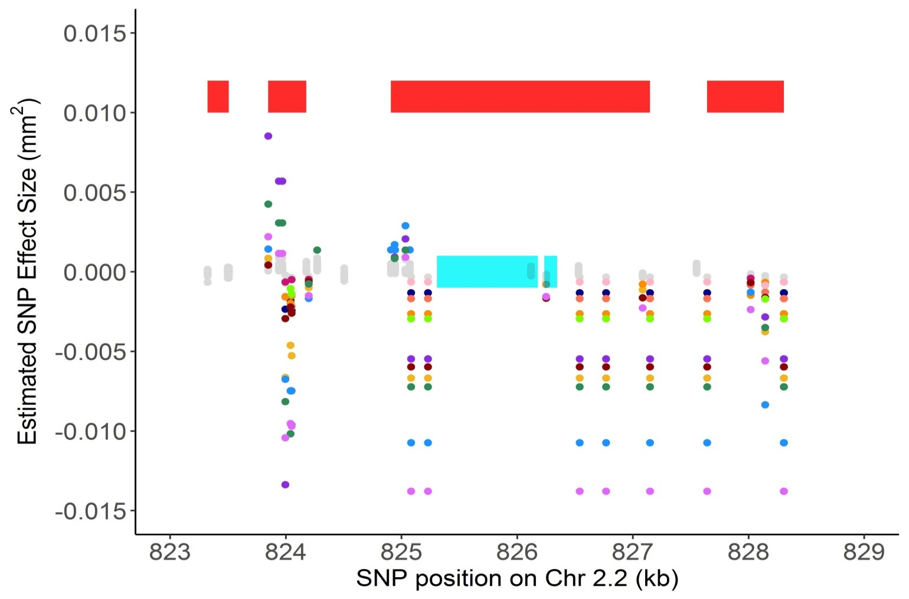
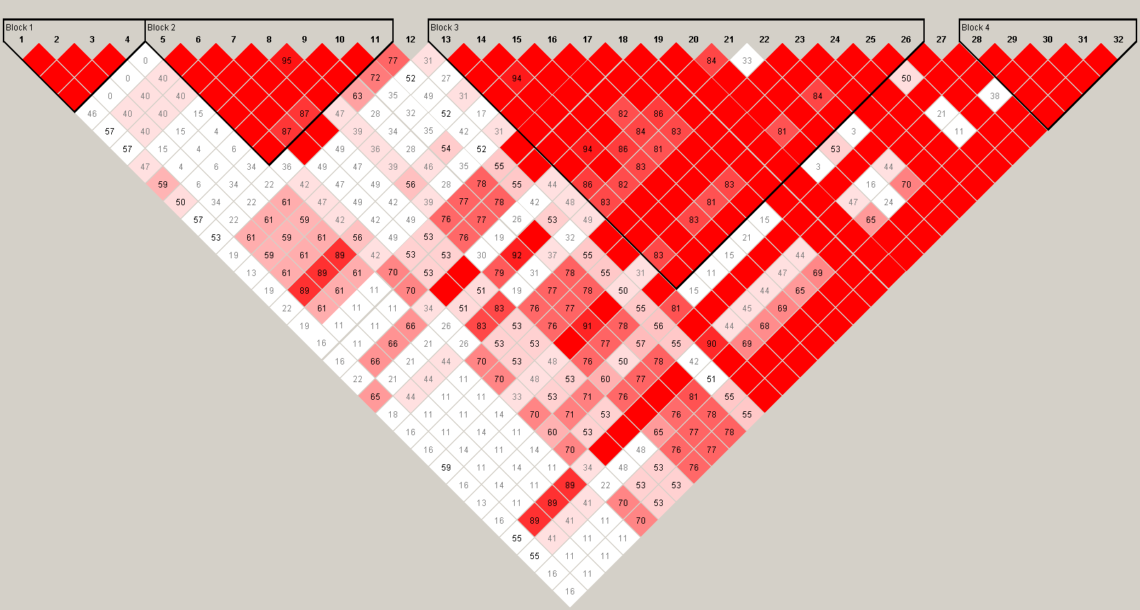
a
Block 1
Block 2
Block 3
Block 4
b
Notes:
Figure 6.

